Slide 1


C-MAC
ELECTRONICS SOLUTIONS
CONFLICT
MINERALS REPORTING
ACCORDING TO
RESPONSIBLE MINERALS INITIATIVE
WWW.CMAC.COM

Slide 2
TABLE OF
CONTENTS
1
Introduction
2
Conflict Mineral Reporting
3
Critical Raw Materials Reporting
4
Frequency & attention

Slide 3
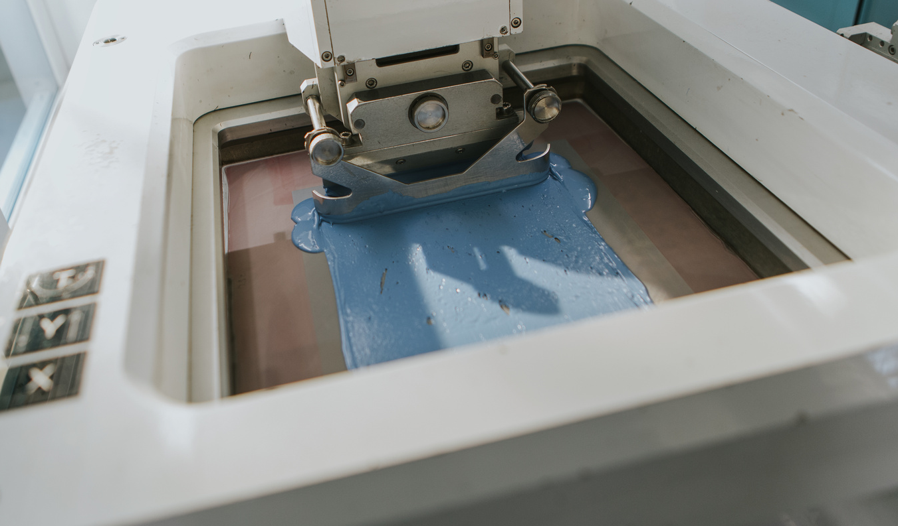
Introduction
C-MAC Electromag expects of itself and its suppliers that all products supplied by C-MAC Electromag shall be free from conflict minerals originating from entities financing, directly or indirectly, conflicts in the Democratic Republic of Congo or neighbouring countries, as well as any mining activity located in conflict or high-risk areas.
C-MAC Electronics Solutions
01

Slide 4


Conflict Minerals
Reporting
What are Conflict Minerals?
The term “conflict minerals” is defined as gold, tantalum, tin, tungsten, cobalt, and mica
and any other mineral or its derivatives. These are raw materials that come from areas
affected by conflict and can be used to finance armed groups, fuel forced labor, and support
human rights abuses and corruption.
Which reporting templates to use?
3TG (Tin, Tantalum, Tungsten and Gold) - The Conflict Minerals Reporting Template (CMRT)
is a free, standardized reporting template developed by the Responsible Minerals Initiative
(RMI) that facilitates the transfer of information through the supply chain regarding mineral
country of origin and the smelters and refiners being utilized.
Cobalt, Mica, Copper, Graphite, Lithium, Nickel - The Extended Minerals Reporting
Template (EMRT) is a free, standardized reporting template developed by the Responsible
Minerals Initiative to identify pinch points and collect due diligence information in the
cobalt and mica supply chains.
Need help filing in the reporting template?
CMRT Completion Guideline & Template
EMRT Completion Guideline & Template
C-MAC Electronics Solutions
02

Slide 5
Critical Raw Materials
Reporting
What are Critical Raw Materials?
The term “critical raw materials” refers to raw materials that are economically and
strategically important for the European economy but having a high risk associated with their
supply. Like Aluminium/ Bauxite, Glass, Magnesium, Manganese, Palladium,
Platinum-Platinum group metals, plastics, rare earth elements (Samarium, Gadolinium,
Terbium, Dysprosium, Lutetium, Scandium, Yttrium), Rubber (natural), Steel, Zinc.
Which reporting templates to use?
The Additional Minerals Reporting Template (AMRT) is a free, standardized reporting
template developed by the Responsible Minerals Initiative to identify pinch points and
collect due diligence information for minerals not covered by the Conflict Minerals
Reporting Template (CMRT) and Extended Minerals Reporting Template (EMRT).
Need help filing in the reporting template?
AMRT Completion Guideline & Template
C-MAC Electronics Solutions
03

Slide 6
frequency and attention
When should these declarations be transmitted?
Send a report upon request each year or at each new version of the template edited by the Responsible Minerals Initiative -RMI.
Smelters require attention.
Make sure that:
  Smelters or refineries have a valid certification code.
  Smelters or refineries are not located in areas of persistent geopolitical concern and international sanctions.
Smelters Reference Lists
We appreciate your commitment to ethical sourcing and your cooperation in helping us ensure
transparency and accountability throughout our supply chain.
C-MAC Electronics Solutions
04

Slide 7
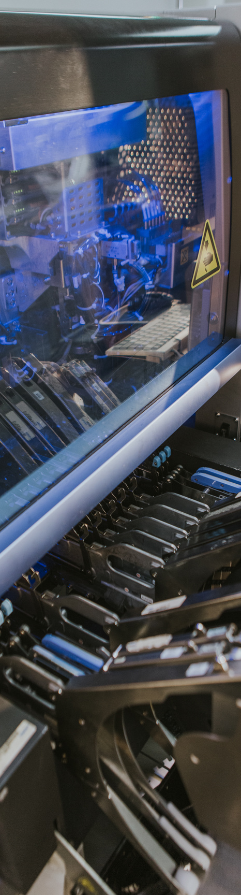
www.cmac.com
C-MAC
Electronics Solutions

